Slide 1
Local Enterprise Office
Tipperary
Funding Seminar
Who To Talk To
Eleanor Forrest

Slide 2
Introduction
In 1993 County and City Enterprise Boards were set up by Government as Companies limited by guarantee with 15 local directors to promote and encourage local enterprise. There were 35 Boards nationally charged with implementing local enterprise action plans funded by the Department of Jobs, Enterprise & Innovation.
On 14 April 2014 the Government dissolved the 35 Limited Companies and established 31 Local Enterprise Offices within the Local Authorities. The LEO operates under a Service Level Agreement between Enterprise Ireland and the Local Authority and will continue to grow and develop micro and small business at local level.
The Local Enterprise Office is the First Stop Shop for anyone seeking information and support to start or grow a business in Ireland.
A Government initiative under the Action Plan for Jobs, the network of Local Enterprise Offices will deliver an enhanced and more integrated support service for micro and small business and will build on the significant achievements of the County & City Enterprise Boards over a 20 year period.

Slide 3
Supports
Selective Financial Intervention
  Financial assistance is awarded under three headings
    Priming Grants (<18 months trading)
    Business Expansion Grants (>18 months )
    Feasibility/technical assistance Grants
Entrepreneurial and Capability Development
    Enterprise awareness / enterprise culture
    Advice, information, counselling, mentoring, training.
    Management Development Programmes

Slide 4
Primary Responsibility
Commercially viable projects with job creation potential
Creation and development of sustainable micro-enterprises
Projects – up to 10 employees
Capital investment – unlimited
Priority to enterprises in the manufacturing & internationally traded services sector with the potential to develop strong export portfolios.
Locally traded enterprises promoted by the unemployed, those recently made redundant and women re entering the workforce.

Slide 5
Priming Grants
50% of investment to a max of €150,000 whichever is the lesser.
  Note: €150,000 will be exception in most cases it will be 50% of investment to a max of €80,000 whichever is the lesser. Grant applications in excess of €40,000 will be referred to Enterprise Ireland for adjudication.
Subject to the above limits a max grant of €15,000 per job created shall apply.
Eligible clients may be awarded a Priming Grant in the first 18 MONTHS of setting up
Support can cover all business costs directly attributable to starting or growing & developing the business i.e. Capital, Salary Costs, Rent etc

Slide 6
Business Expansion Grants
50% of investment to a max of €150,000 whichever is the lesser.
  Note: €150,000 will be exception in most cases it will be 50% of investment to a max of €80,000 whichever is the lesser. Grant applications in excess of €40,000 will now be referred to Enterprise Ireland for adjudication.
Subject to the above limits a max grant of €15,000 per job created shall apply.
Business must be in operation longer than 18 Months. A business that has availed of a priming grant will be ineligible to apply until 18 months after drawdown of priming grant,
Support can cover all business costs directly attributable to growing & developing the business i.e. Capital, Salary Costs, Rent etc

Slide 7
Eligible Costs - Priming Grants & Business Expansion Grants
Capital Costs. Fit out of workspace, office equipment, machinery (new & second hand), computer costs hardware and software. Exclude laptops, mobile assets, mobile phones
Salary Costs- Two instalments. Maximum €15,000 for positions paying €40,000. Minimum wage - grant €7,500. Appropriate in between scales. (option to pay in 2 moieties where circumstances necessitate)
Rental/Accommodation Costs – 1st year. May be paid up-front. If space is already subsidized then differential between market and subsidized rate is only eligible.
Utility Costs – Installation/Upgrade of Telephone & Broadband.
5. Marketing Costs – Packaging, Brochures, Business Cards, Trade Fairs, Website Design & Development, Other Marketing Initiatives.

Slide 8
Eligible Costs (cont’d)
6. Consultancy Costs - Design Fees, Patent Costs, Accountant, Legal Fees
7. Business Specific Training- Specific training integral to the operation/success of the business e.g. AutoCad. (Training may be certified or non-certified)

Slide 9
Feasibility Grants
50% of investment to a max of €40,000 or €20,000 whichever is the lesser.
Eligible Expenditure includes
      Product/ prototype development
      Market Research Consultants fees
      Financial Evaluation
      Own Time €400 p.w. (Capped at 20% of study costs)
      Overseas travel
      Domestic Travel & subsistence
      Telephone/ admin etc.
Paid based on vouched expenditure & Report

Slide 10
Refundable Aid
Each Local Enterprise Office has an obligation to ensure that at least 30% of total approvals must be in refundable form.
This means that grant aid will be structured so that it is part grant and part loan. This loan is interest free and generally repaid by agreement over a maximum of 3 years .

Slide 11
Ineligible Enterprises
Retail/Wholesale
Personal services (e.g. hairdressers, gardeners etc),
Professional services (accountants, solicitors etc)
Construction
*Due to unacceptable dead weight where projects would proceed anyway or displace business from others

Slide 12
The Project Evaluation Process – 6 Core Principles
Commercial Evaluation: Is there a market for the proposed product or service and can the project secure a requisite share of the market?
Financial Evaluation: Can the project secure and repay the requisite financial investment (fixed and working capital)
Management Evaluation: Can the promoters and their management team successfully address the business development and business as usual agendas of the project?
Technical Evaluation: Are there any technical barriers to successful implementation (product or process) and can they be overcome?
Economic Evaluation: Is there a potential economic and exchequer return on the taxpayers investment – jobs direct, indirect?
Funding Evaluation: How can taxpayers money best be used to support the project and optimise its potential?

Slide 13
BUDGETS/ Exchequer Allocations -Tipperary
MEASURE 1 – €366,808
MEASURE 2 – €378,952
Own Resource Income - €71,000
REFUNDABLE AID – €618,384
Note : These are indicative amounts

Slide 14

Entrepreneurial
&
Capability Development

Slide 15
First Stop Shop
Advice, Information and Assistance
Access to Organisations such as
    Small Firms Association
    Irish Exporters Association
    ISME
On line Resources
    National and Local Enterprise Office Website
    SME Online Tool www.localenterprise.ie/smeonlinetool/
    Tipperary Directory
    NUBIE.ie

Slide 16
Programmes
Pre start up –
      SYOB,
      Business Boot Camps
      Work life Balance etc
Existing Businesses
    Business Skills Training
      HR Management,
      Customer Service,
      Taxation & Financial Management for Small Business
      Sales, Marketing & ICT
    Company Specific
      Mentoring,
      Management Development Programme/ Accelerate
      Smart Knowledge Programme

Slide 17
Mentoring / Temporary Business Advisors
On Site Diagnostic
Experienced Panel
Nominal Fee
Written Report
Financial Planning
Costing / Taxation
Production Planning
Business Structures
Sales
Marketing & Branding
Health & Safety
Prototype Development
HR Management

Slide 18

Train to Gain

Slide 19
Smart Knowledge
How to commercialise an idea
Mapping your Business Model
Driving Innovation in your business
Creativity & Knowledge
Exploring the Route to Market
Service & Product Prototyping
Assessing Risk
Brand Innovation

Slide 20
Grant Schemes
Tailored to Business Needs
Website Development - €1,000 or 50%
Exhibition Grants - €1,000 or 50%
Export Market Support - €3,000 or 50%
Market Entry Support
Branding and Design
Community Enterprise Initiatives
Training Supports – 50%
    Subject to no other Agency funding

Slide 21
Additional Activities
Workspace Study
Training Needs Analysis
Schools programmes
Link to EI Schemes such as
        Get Export Ready
        Hi Start
        Innovation Vouchers
        New Frontiers
  County Networks
        Women’ s Networks
        Green Business Network
        Food Producers Network
        SMILE
Representation & Linkage (EWG, Leader, TCEC, TEA etc)

Slide 22
Online Trading Vouchers
To Support SME’s enhance their online trading presence.
ONLINE TRADING VOUCHERS to the value of €2,500 are now being made available under the National Digital Strategy with a €5m fund available nationally.
Who is Eligible
    Businesses – any sector (with a limited online presence)
    T/o < €2 Million
    < 10 staff
What is eligible
    Development or upgrade of an e-commerce website such as implementing online payments or booking systems
    Purchase of internet related software
    App development
    ICT consultancy for developing an online strategy
    Web based advertising campaigns
    50% of eligible expenditure

Slide 23
Online Trading Vouchers
Two Information Seminars - Admission Free
    Clonmel Park Hotel Wed 17th Sept
    Abbey Court Nenagh Monday 22nd Sept
    (7.30 – 9.00pm)

Slide 24
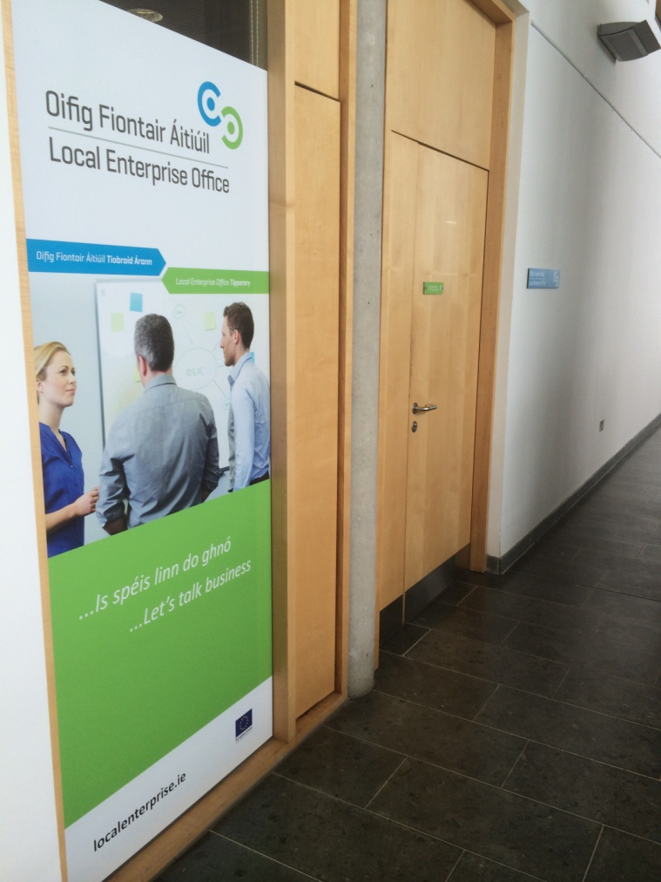
Where to Find Us
Local Enterprise Office Tipperary
Ballingarrane House,
Ballingarrane Science & Technology Park,
Cahir Road, Clonmel
&
Civic Offices,
Limerick Road,
Nenagh,
Telephone: 07 61 06 5000
Email: LEO@tipperarycoco.ie

